Slide 1
Proxies for climate reconstructions
Geological observations
Large fossil indicators of past climates
Geochemical indicator
Relative abundance of stable isotopes
Concentration of Mg in fossils
Concentrations of organic compounds in fossils
Microfossils as indicators of past climate
Foraminifera
Pollen
CaCO₃ precipitates from caves
Ice cores

Slide 2
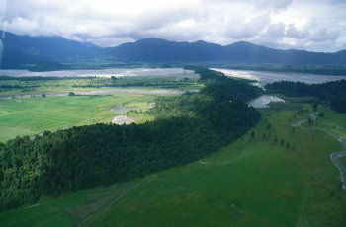
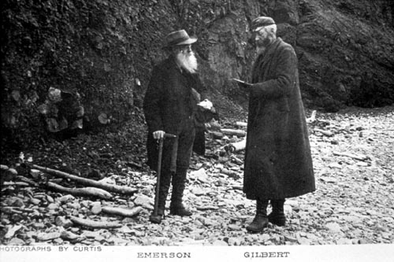
Geomorphic indicators of past climates: Moraines (rock pile at maximum extent of glacier)
Younger Dryas
Waiho Loop Moraine,
New Zealand
Alaskan Moraine
19th century expedition

Slide 3
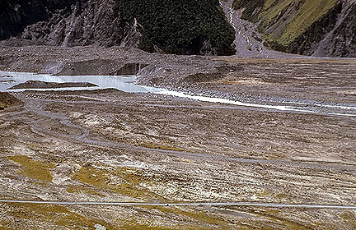
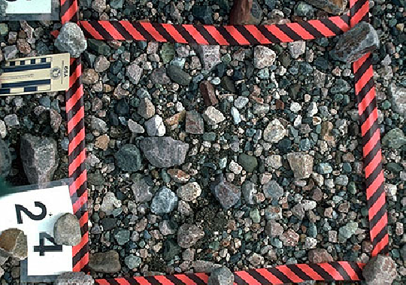
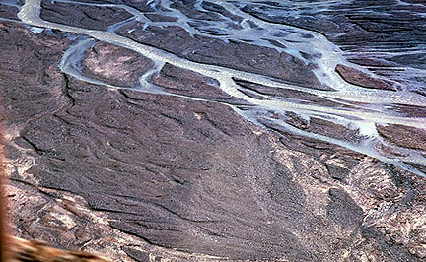
Geomorphic indicators of past climates: stream deposits
Proglacial stream, New Zealand
Proglacial braided streams, Alaska
Outwash clasts, Iceland

Slide 4
Diamictite – rock fragments of all different sizes, with up to 25% of the mass > 2mm in size. Diamictites are often glacial debris but may also form from stream deposits

Slide 5
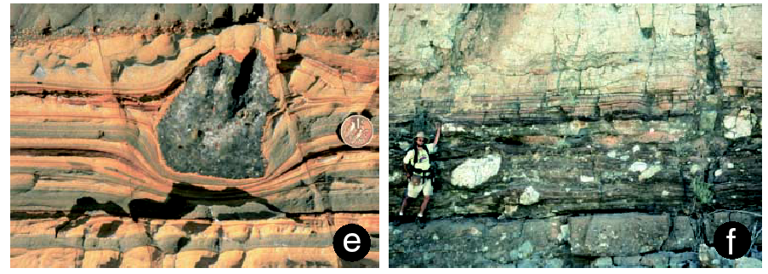
Geomorphic indicators of past climates: Dropstones in Neoproterozoic sediments
Note coin for scale
Note person for scale

Slide 6
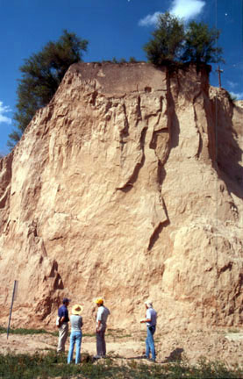
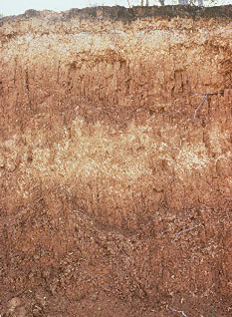
Geomorphic indicators of past climates: Loess and paleosols
Loess (depositional) and paleosols (darker layers signifying weathering and organic depostion during wetter period)
Loess (windblown dust deposit, signifying aridity)

Slide 7
Fossil indicators of past climates
Vegetation
Plants have obvious preferences for mean annual temperature, mean annual precip, and seasonality of both properties
Pollen important for recent times
Plants adapt to environmental change (higher CO2 = fewer stomates)
Animals have temperature requirements
Particularly cold blooded animals
Plant and animal microfossils in the oceans have temperature preferences and tolerances

Slide 8
Isotopes that are indicators of past climates
Hydrogen
¹H, ²H (0.02%); ²H is also known as “deuterium”
δD (or δ²H) = [(D/H)_{sample} / (D/H)_{ref} -1] x 1000
Oxygen
¹⁶O, ¹⁷O (0.04 %), ¹⁸O (0.20 %)
δ¹⁸O = [(¹⁸O/¹⁶O)_{sample} / (¹⁸O/¹⁶OH)_{ref} -1] x 1000
Carbon
¹²C, ¹³C (1.1 %)
δC = [(¹³C/¹²C)_{sample} / (¹³C/¹²C) _{ref} -1] x 1000

Slide 9
Nature of isotope effects
Physical isotope effects
Evaporation and precipitation (δ¹⁸O_{gas} = δ¹⁸O_{water} - 7 ‰)
Diffusion (gases of light isotopes diffuse faster than gases of heavy isotopes)
Chemical equilibrium isotope effects
Example: fractionation of O isotopes between H₂O and CO₃²⁻
H₂¹⁶O + C¹⁶O₂¹⁸O²⁻ = H₂¹⁸O + C¹⁶O₃²⁻
K = [H₂¹⁸O] [C¹⁶O₃²⁻] / [H₂¹⁶O] [C¹⁶O₂¹⁸O²⁻]
K is a function of temperature
Chemical kinetic isotope effects
Example: CO₂ assimilation during photosynthesis
¹²CO₂ + H₂O --> ¹²CH₂O + O₂
¹³CO₂ + H₂O --> ¹³CH₂O + O₂
k(¹³CO₂) / k (¹²CO₂) ~ 0.980 for C3 photosynthesis (trees, flowering plants, some grasses

Slide 10
Paleotemperatures using δ¹⁸O of CaCO₃
K = [H₂¹⁸O] [C¹⁶O₃²⁻] / [H₂¹⁶O] [C¹⁶O₂¹⁸O²⁻] = function of temperature
Paleotemperature equation:
T(˚C) = 16.9 - 4.38*(δ_{calcite} - δ_{water}) + 0.10*(δ_{calcite} - δ_{water})²
At 16.9˚, dT/dδ ~ - 4.38; dδ/dT ~ - 0.23 ‰ /˚C.
Standards:
Water: SMOW (Standard Mean Ocean Water)
Calcite: PDB-1 (Pee Dee formation Belemnite -1)
Complication: One needs to know δ_{water}.
Modern ocean: δ_{water} varies with salinity by ~ 1 ‰ (evaporation increases δ_{water})
Pleistocene ocean: δ_{water} varies with ice volume (~ 1 ‰ higher during glacial maximum)
Pre-Cenozoic ocean: δ_{water} is not known; may been ~ 0.5 ‰ less than today
Freshwater environments: very hard to know δ_{water}
Hydrologic fractionations:
Discrimination against ¹⁸O during evaporation
Discrimination favoring ¹⁸O during precipitation
Problem: diagenesis
CaCO₃ recrystalizes: CaCO₃ + H₂O --> Ca²⁺ + 2HCO₃⁻ --> CaCO₃ + H₂O
δ¹⁸O_{calcite} depends on recrystalization temperature and δ¹⁸O of pore-space waters
For forams, recrystalization becomes important after 10’s of millions of years

Slide 11
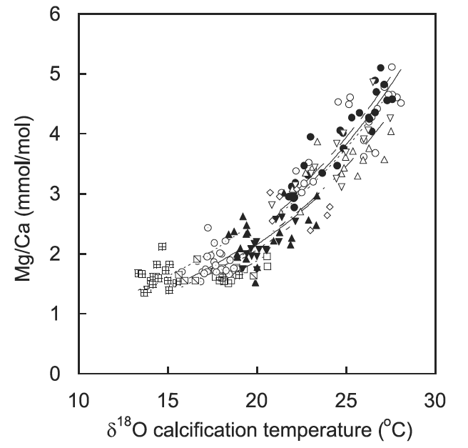
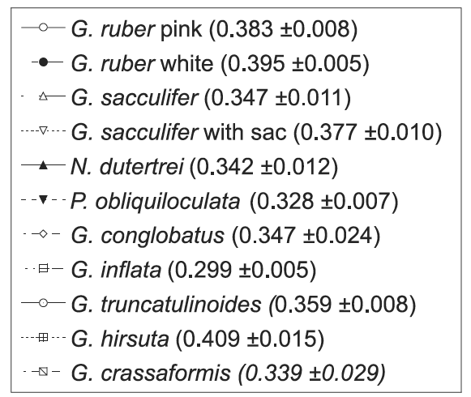
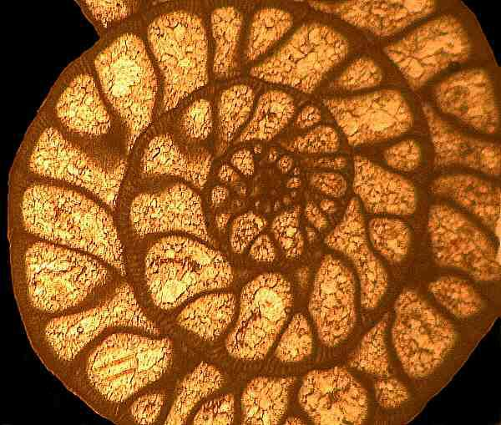
Mg/Ca in forams and paleotemperatures
Basic evidence for temperature dependence: one experiment
Collect sinking forams in sediment traps to get temperature range
Measure temperature of the water
Measure Mg/Ca and compare with growth temperature
Derive curves of Mg/Ca vs. temperature for each species
Mg/Ca + xe^{0.090T}
Cross section of a foraminifera shell

Slide 12
Paleotemperatures from the uk’37 index of alkenone undersaturation
Alkenones are hydrocarbon compounds with long chains of carbon atoms (37 in this case)
Most of the carbon atoms are linked by single bonds (they are saturated, each bonding with enough H atoms to fill up the valence state)
Some of the C atoms are linked by double bonds (undersaturated)
Coccolithofoids produce these alkenones (coccolithoforids are phytoplankton that make CaCO₃ shells)
The position of double bonds changes as a function of temperature to regulate the viscosity of the cell fluid
In chemical notation, numbers indicate the position of double bonds

Slide 13
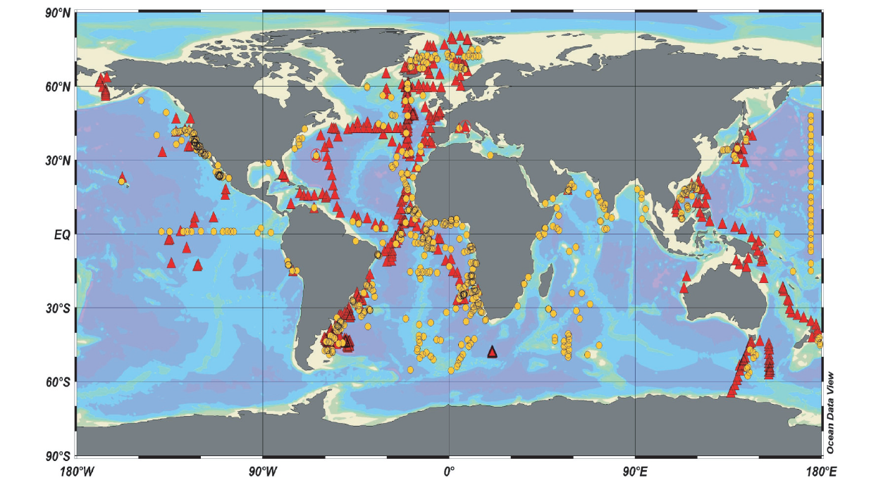
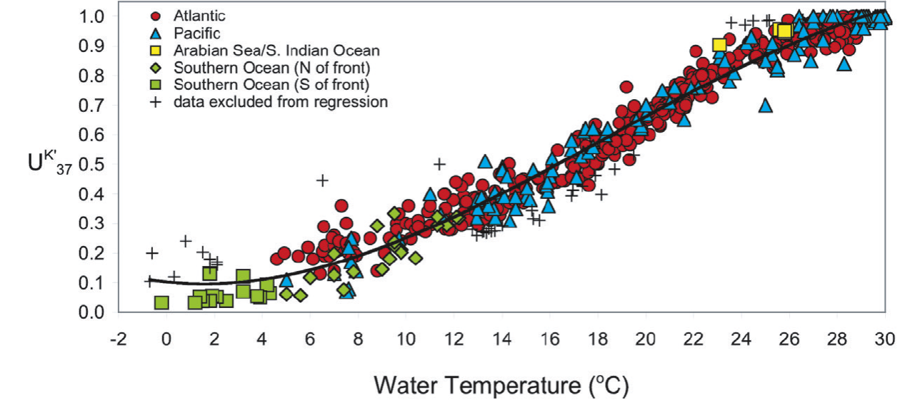
Uk’37 in surface seawater samples vs. collection temperature
For core top samples there is a compact relationship between Uk’37 and temperature
Trends are similar for all oceans
Sensitivity is poor above 25˚C and below 6˚C
Conte et al 2006

Slide 14
Faunal reconstructions of past temperatures: an example based on the modern analog technique
All foraminifera have temperature preferences and tolerances
The species composition of a fossil foram assemblage depends on temperature
The reconstructed temperature will be most accurate if we look at the abundance of all the forams species in the sample)
The temperature dependence of modern assemblages is the reference
The temperature of a fossil assemblage is the temperature of the most similar modern assemblage

Slide 15
Illustration of temperature dependences of forams: menardii likes warmer waters than pachyderma
Pachyderma abundance vs. water temp.
Menardii + tumida abundance vs. water temp.

Slide 16
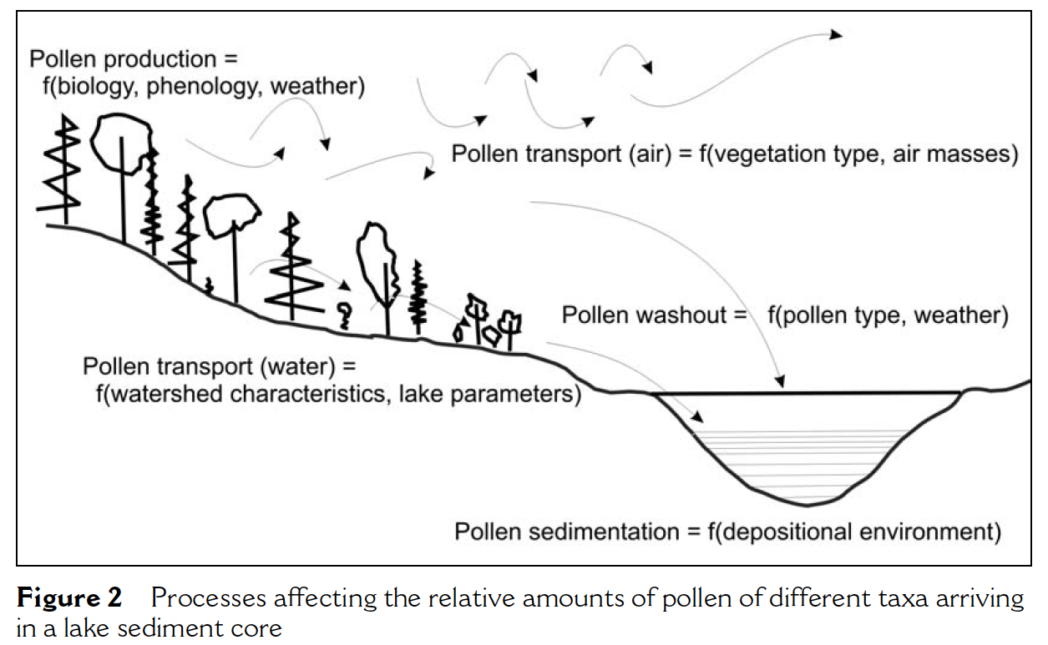
Climate reconstructions from pollen
Most pollen records come from lake sediments
Also some records from nearshore ocean sediment cores
Fossil species assemblages record the presence or absence of fossils in past times
Pollen abundance depends on
Proximity of biomes (trees that are abundant near the lake are overrepresented)
Production
Atmospheric transport
Removal processes (precipitation, dry fallout)
Gajewski,2008

Slide 17
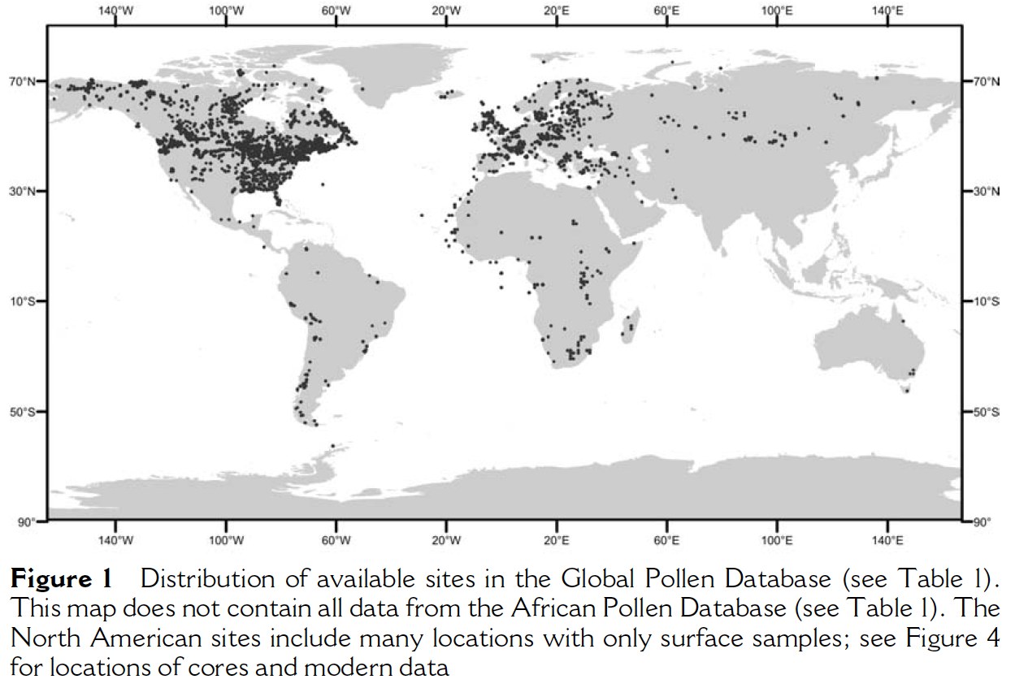
Modern pollen database serves to calibrate fossil assemblage paleotemperatures

Slide 18
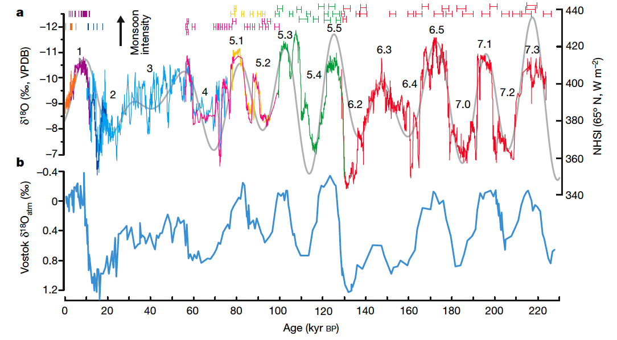
Climate records from CaCO₃ precipitates in caves

Slide 19
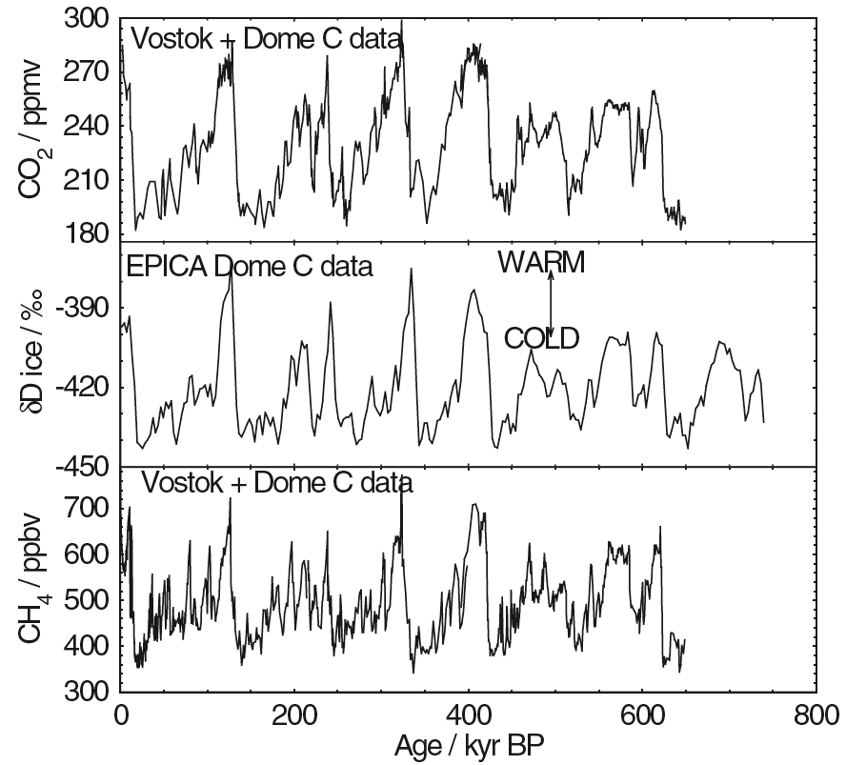
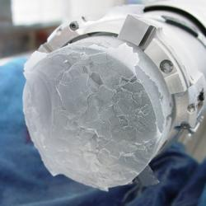
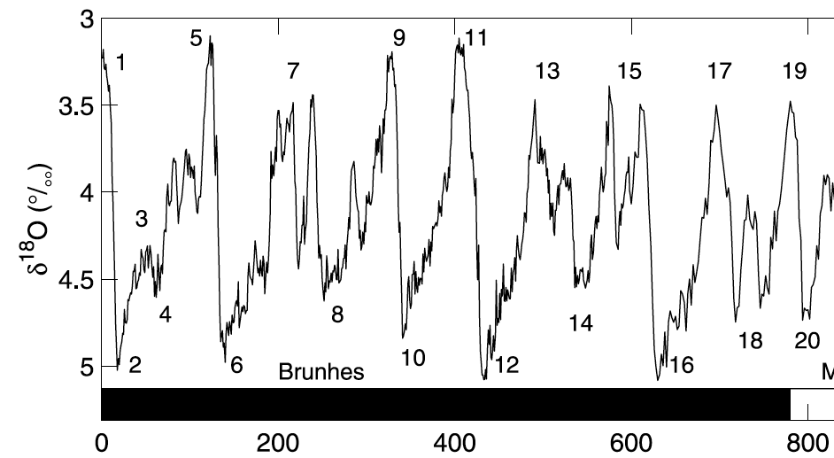
Temperature, CH₄, and CO₂ records from the Vostok ice core
CO₂
Isotopic temp of ice
CH₄
Foram δ¹⁸O
δ¹⁸O of CaCO₃ (‰) (colder, more ice)
0 ka
200 ka
400 ka
600 ka
800 ka

